Slide 1


PROJECT COMPLETION REPORT
August 2024

Slide 2

Contents
01 02
03
Introduction
Key "Wow" Insight
04
Key Findings
Recommendations

Slide 3

Introduction
The project aimed to explore the learning aspirations and career motivations of individuals across various demographics. By analyzing responses related to influencing factors, education sponsorship, and workplace expectations, the project sought to understand the underlying drivers that shape career decisions and long-term job satisfaction. The initial problem statement revolved around identifying what factors significantly impact individuals' aspirations and how these could be leveraged to enhance employee engagement and retention.

Slide 4



Key Findings
Parental Influence Dominates Career Aspirations
High Willingness for Self-Sponsored Higher Education
The data revealed that parental influence was the most significant factor shaping individuals' career aspirations. This insight highlights the strong role of family in career decision-making, particularly in the Indian context, where 34% of respondents cited "My Parents" as the key influencing factor.
A notable finding was that a large proportion of respondents (46%) expressed their willingness to self- sponsor their higher education. This indicates a strong personal drive for educational and professional advancement, with many individuals prepared to invest in their future despite potential financial challenges.

Slide 5

Conditional Commitment to Employers
Unclear Goals Cause Workplace Frustration
When asked about their likelihood to remain with an employer for at least three years, many respondents indicated that while this commitment would be challenging, they would stay if the conditions were right. Specifically, 58% of respondents felt that they could commit to their job if the workplace environment and growth opportunities met their expectations.
One of the most striking findings was that "Unclear work without any goals" was a top frustration factor for employees. This suggests that lack of clarity in job roles and expectations is a significant pain point, negatively impacting job satisfaction and potentially leading to higher turnover rates.

Slide 6
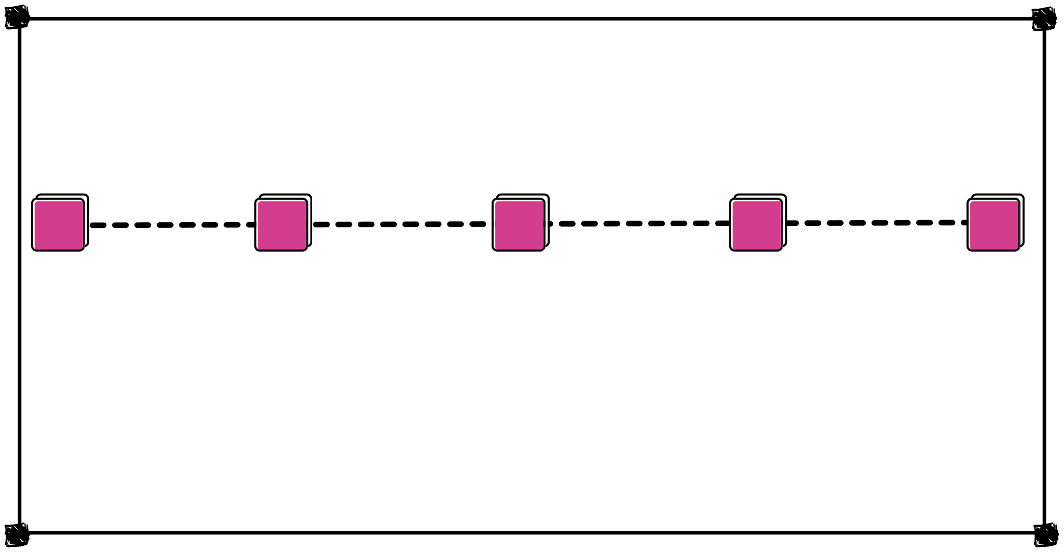
"Wow" Insights
01
02
03
04
05
Parental Influence
Self-Sponsorship Willingness
Unclear Work Goals
Gender Disparity
Commitment Conditional on Environment

Slide 7

Parental Influence: The overwhelming impact of parental influence on career aspirations was striking, highlighting the importance of family in career decisions.
01
Insight: One of the most surprising findings was the overwhelming impact of parental influence on career aspirations. A significant 34% of respondents cited their parents as the most critical factor in shaping their career decisions. This insight underscores the deep-rooted cultural values in the Indian context, where family, particularly parents, plays a pivotal role in guiding career choices.
02
Impact: This finding is crucial for employers and educational institutions. Understanding the importance of parental influence can help organizations tailor their communication and career development programs to align with family expectations, potentially leading to higher employee satisfaction and retention.

Slide 8
Self-Sponsorship Willingness: A large proportion of respondents showed a willingness to self-sponsor their higher education, indicating a strong drive for self-improvement.
01
Insight: Another remarkable discovery was the high willingness of individuals to self- sponsor their higher education. A substantial 46% of respondents indicated that they were ready to invest in their education, even if it meant bearing the financial burden themselves.
02
Impact: This insight highlights a strong personal commitment to professional growth and advancement. For organizations, this presents an opportunity to offer support structures, such as tuition reimbursement programs or flexible work arrangements, to attract and retain talent who are already motivated to enhance their skills.

Slide 9
Unclear Work Goals: The top frustration factor being "unclear work without any goals" was a surprising insight, emphasizing the critical need for clarity in job roles.
01
Insight: A striking insight was that "Unclear work without any goals" emerged as one of the top frustration factors among employees. This lack of clarity in job roles and expectations significantly impacted job satisfaction, leading to disengagement and potential turnover.
02
Impact: This finding is a wake-up call for employers. It emphasizes the need for clear communication of work objectives and regular feedback. By providing employees with well-defined goals and a clear sense of purpose, organizations can improve job satisfaction and reduce frustration levels.

Slide 10
Gender Disparity: The significant gender disparity, with a majority of male respondents, suggests a need to explore gender-specific career aspirations in future studies.
01
Insight: The survey revealed a significant gender disparity, with male respondents constituting about 60% of the sample. This finding was unexpected and indicates a potential gender bias in the survey distribution or response rate.
02
Impact: This disparity highlights the need for future studies to focus on understanding the career aspirations of women and how they differ from men. By addressing this gap, organizations can develop more inclusive strategies that cater to the diverse needs of their workforce, ensuring that all employees feel valued and supported.

Slide 11
Commitment Conditional on Environment: The finding that many are willing to stay with a company for three years if conditions are right, highlights the importance of a supportive work environment.
01
Insight: While many respondents indicated a willingness to stay with their current employer for at least three years, this commitment was highly conditional. Specifically, 58% of respondents stated that their decision to stay depended on the right workplace conditions, including opportunities for growth, a supportive environment, and fair compensation.
02
Impact: This conditional loyalty suggests that employers need to be proactive in creating a work environment that meets employees' expectations. By addressing the factors that contribute to job satisfaction, organizations can increase employee retention and reduce turnover.

Slide 12

Recommendations for Future Projects
Increase Stakeholder Involvement
Leverage Advanced Data Analytics Tools
Allocate Sufficient Time for Data Collection and Analysis
Enhance Survey Design and Distribution

Slide 13

THANK YOU!

